Slide 1
Capstone Project
Startup Funding Prediction
Shubham Sharma

Slide 2

The Entrepreneurship journey
Problem Statements
Data Summary
Analysis of Data
Null values Imputation/ Data Cleaning
Data Preparation
Feature Engineering
Model Training
Evaluation Metrics
Challenges
Conclusion

Slide 3

Problem Statement
There has been a staggering growth in investments in young age startups in the last 5 years. A lot of big VC firms are increasingly getting interested in the startup funding space.
The objective of the project is to come up with a machine learning model to predict whether a startup will get funded in the next three months using app traction data and startup details.

Slide 4
Data Summary
The dataset spans over three years from July 2018 to August 2020.
The dataset contains 20 features with more than 15 lakh observations.
Few Features From Dataset
UUID :- Unique identifier for a single startup entity.
Month :- Month for which the app data is available.
Application Category :- The category to which an application belongs to
Average Session Time :- Average time of the session in app during the month (in minutes)
Total Session Time :- Average Session Time/user * open rate
Open Rate :- No. of times app has been opened by a user.
Reach :- % of devices having the app installed
Funding_ind :- Indicator for a funded startup

Slide 5
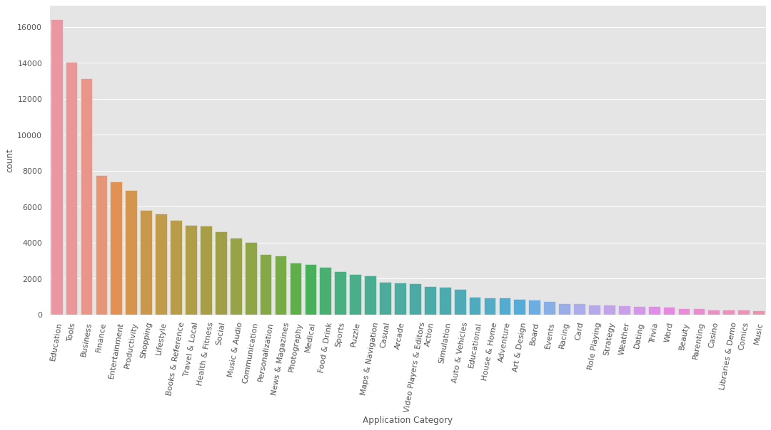
Distribution of Application Category

Slide 6
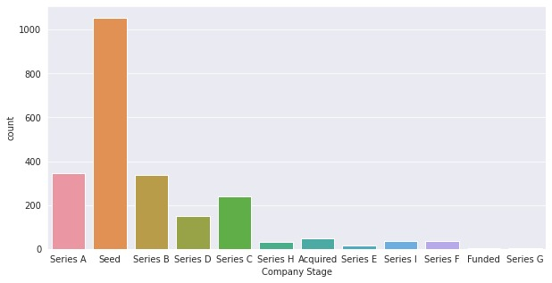
Most of Companies are in Early Stage

Slide 7
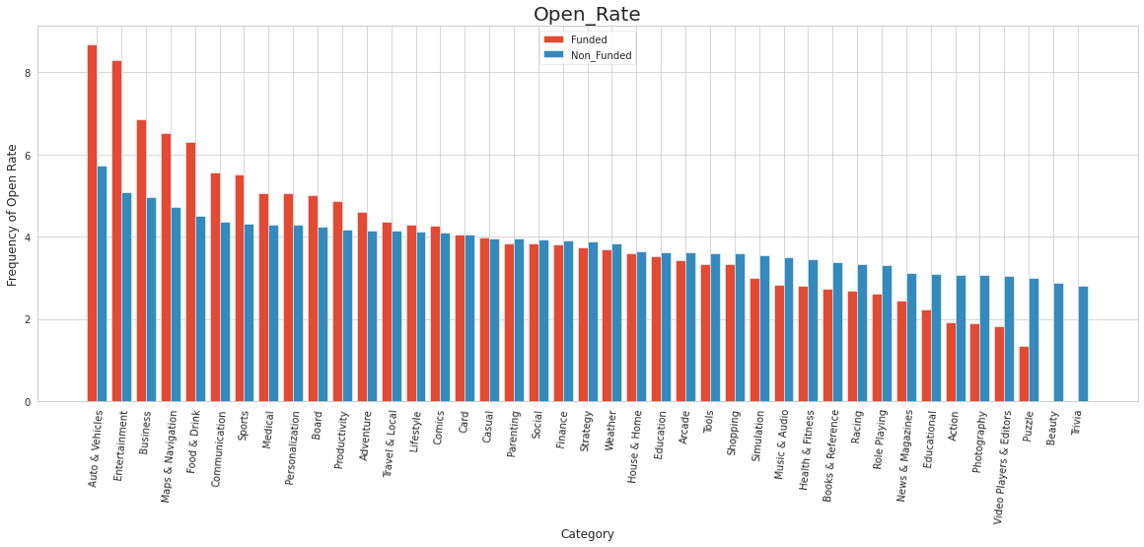
Mean Open Rate (By Application Category)
Average Open Rate

Slide 8
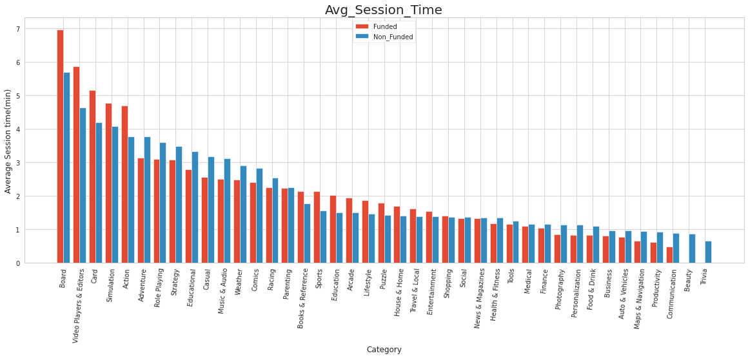
Mean Session Time (By Application Category)

Slide 9
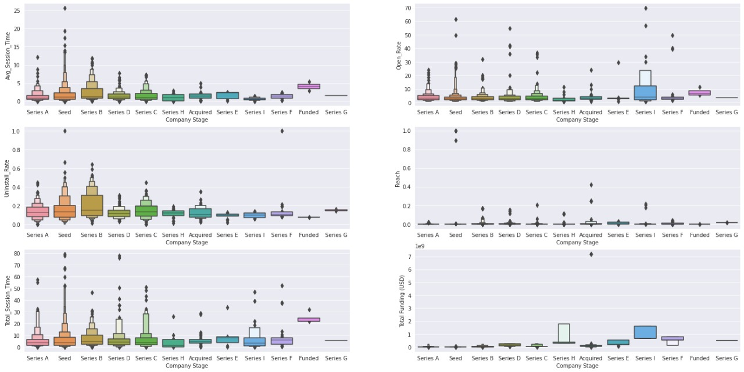
Impacts of Company Stage on App traction

Slide 10
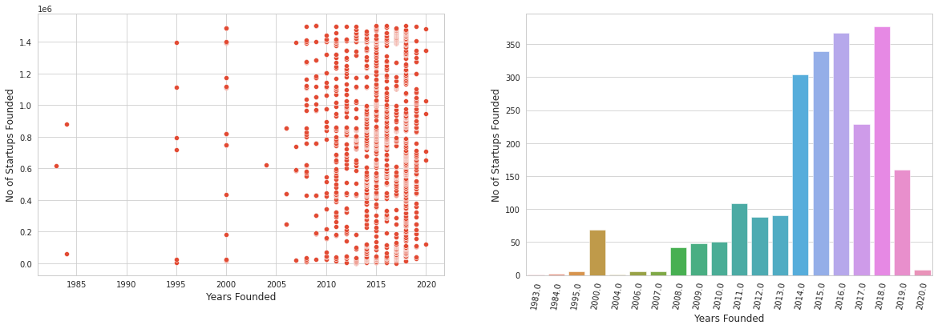
Growth in Startup Ecosystem

Slide 11
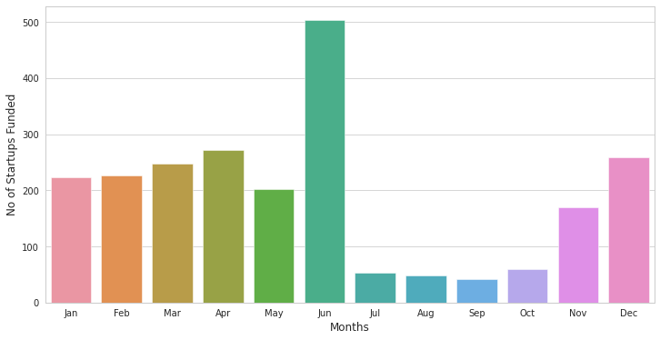
Which Month Brings More Funds?

Slide 12
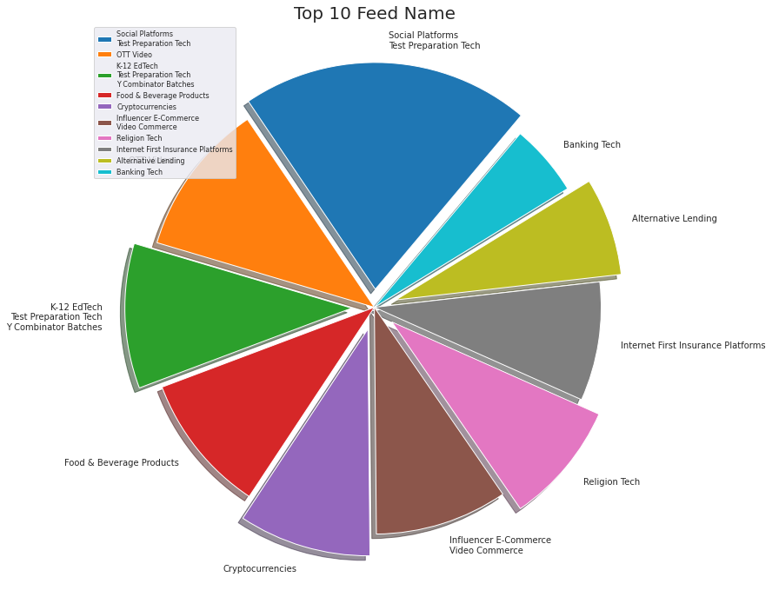
Top 10 Funded Business Domains

Slide 13
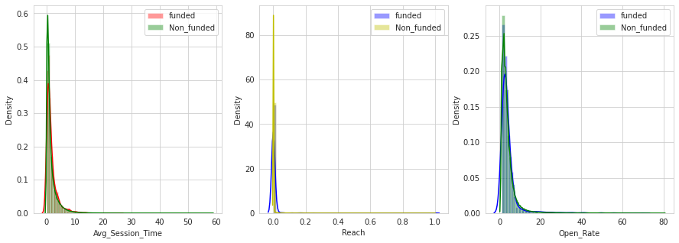
Distribution of app traction features

Slide 14
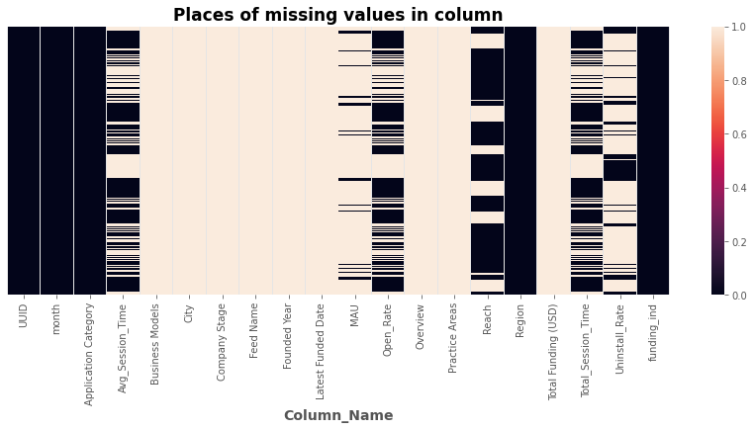
Where are the missing values ?

Slide 15
Data Cleaning
Most of the features contain more than 90% null values.
App traction features are selected for data cleaning includes Average Session Time, Total Session Time, Open Rate, Reach, funding indicator.
Interpolation for imputation followed by forward fill and backward fill.
Interpolation
1 | na | na | 4 | 4
1 | 2 | 3 | 4 | 4

Slide 16
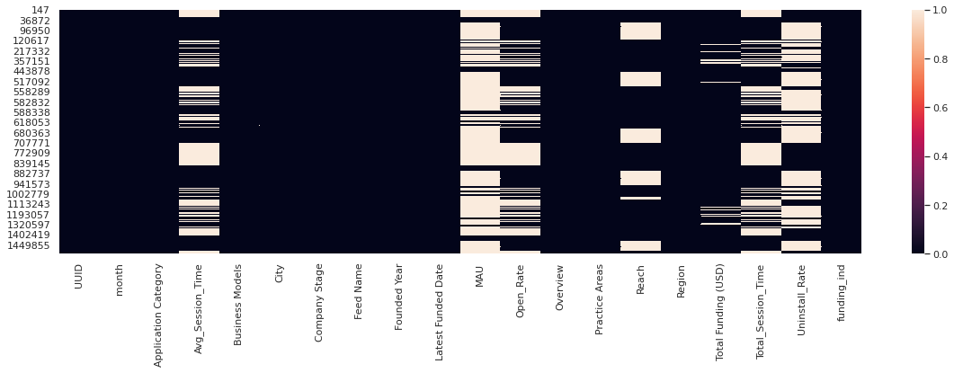
Missing values in funding_ind = 1

Slide 17

Data Preparation
The features we have now aren’t enough to predict.
We created features having the data for previous three months.
There are multiple observations for particular month.
We took the mean of the data grouping by UUID and month.
We Created previous month features for each observation.
We discarded the rows which do not have previous three months of data.
DATA

Slide 18
Data Preparation(contd.)
While Grouping by month and UUID, we will take the mean of Avg_Ses_Time
UUID | month | Avg_Ses_Time
1 | Jan | 5.5
1 | Jan | 4.5
1 | Feb | 4.5
2 | Jun | 5.0
2 | Jun | 7.0
3 | Jul | 7.0

Slide 19
Data Preparation(contd.)
After taking the mean for each month and UUID pair, we will be left with these.
*If the mean of target is greater than zero, then it’s taken to be 1
UUID | month | Avg_Ses_Time
1 | Jan | 5.0
1 | Feb | 4.5
2 | Jun | 6.0
3 | Jul | 7.0
Rows before the operation | Rows after the operation
1502175 | 757290

Slide 20
Data Preparation(contd.)
Rotating the columns UUID and Avg_Ses_Time
UUID | UUID_1 | month | Avg_Ses_Time | Avg_Ses_Time_Prev
1 | 3 | Jan | 5.0 | 7.0
1 | 1 | Feb | 4.5 | 5.0
2 | 1 | Jun | 6.0 | 4.5
3 | 2 | Jul | 7.0 | 6.0

Slide 21
Data Preparation(contd.)
SWe are now left with rows which have previous month of data and the previous month’s averaged characteristics are now appended as new features
UUID | UUID_1 | month | Avg_Ses_Time | Avg_Ses_Time_Prev
1 | 1 | Feb | 4.5 | 5.0
Rows before the operation | Rows after the operation
757290 | 549319

Slide 22
Feature Engineering

Slide 23
Temporally Decayed Weighted Averages of app traction features
Took a look back window of 3 months.
Weights decayed based on time.
Weighted average by given below equation.
Time Decayed Weighted Average=(month1*0.5)+(month2*0.33)+(month3*0.16)

Slide 24
2) Category Dominance
Category dominance features tell us how a particular company performs with respect to the competitors.
Dominance = (Average session time of company X) / (Total Average session time of all the companies in the category of company X)

Slide 25
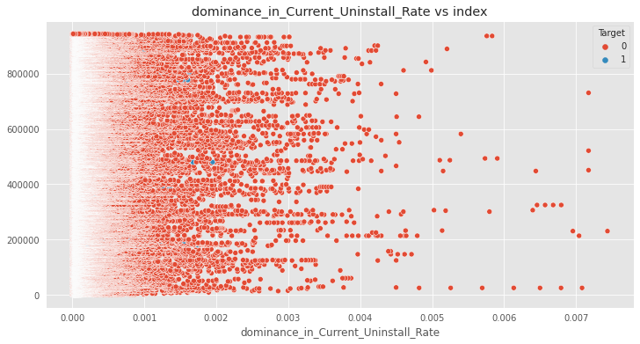
Feature Engineering
Dominance: in its UnInstall Rate

Slide 26
3) Instability Metric
Instability metric captures the fluctuations in the app traction metrics of a company.
Residuals = (Values of feature vector) - (Mean of the feature Vector)
Instability Metric = No. of time sign changes successively

Slide 27
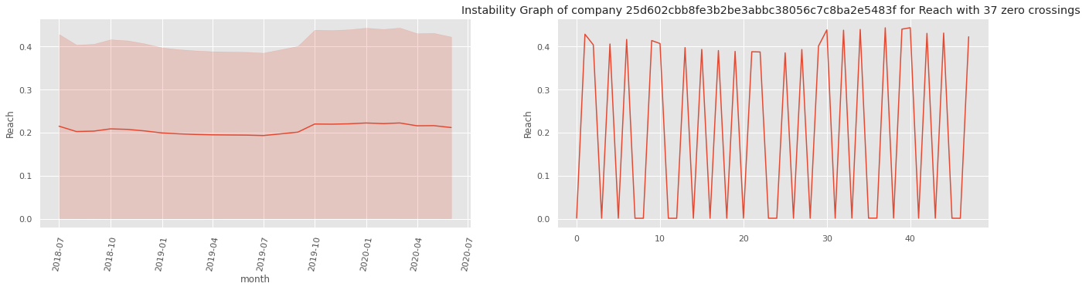
Stability in Funded (Reach)
The left graph shows mean and variance plotted by month, whereas the right graph shows the plot for a single point in reach in a chronological order.

Slide 28
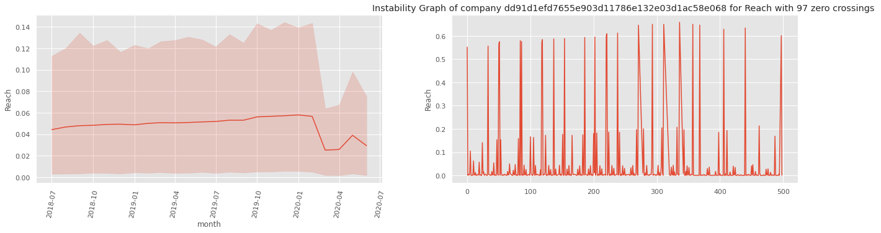
Stability in Non-funded (Reach)
The left graph shows mean and variance plotting by month, whereas the right graph shows the plot for a single point in Reach in a chronological order.

Slide 29
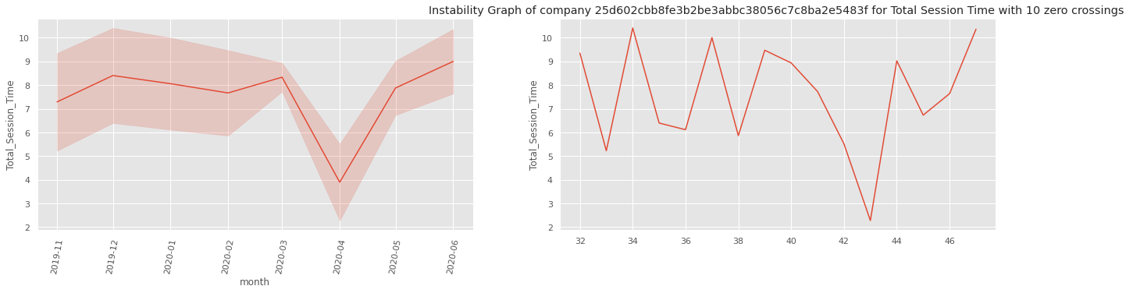
Stability in Funded (Total Session Time)
The left graph shows mean and variance plotting by month, whereas the right graph shows the plot for a single point in Total Time in a chronological order.

Slide 30
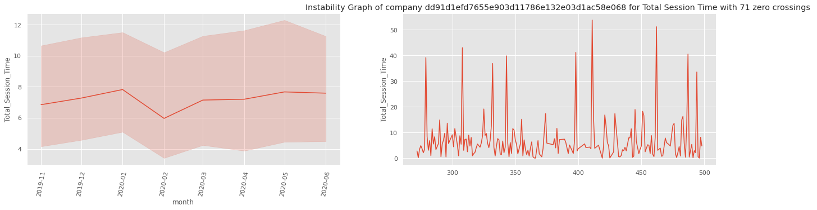
Stability in Non-funded (Total Session Time)
The left graph shows mean and variance plotting by month, whereas the right graph shows the plot for a single point in Total Time in a chronological order.

Slide 31
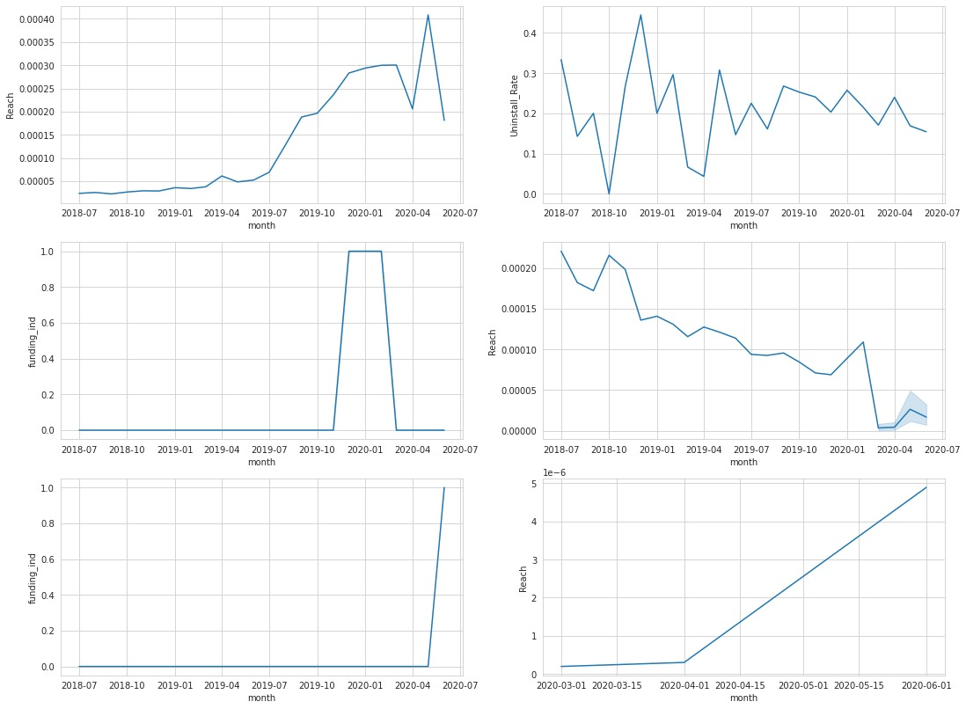
Trend for an individual startup

Slide 32
4) MoM Percentage Change in Traction
Percentage change in app traction features with respect to previous month’s records captures the growth of a company.
% change in Reach = ((Current month Reach) - (Previous month Reach))/
(Previous month Reach)

Slide 33
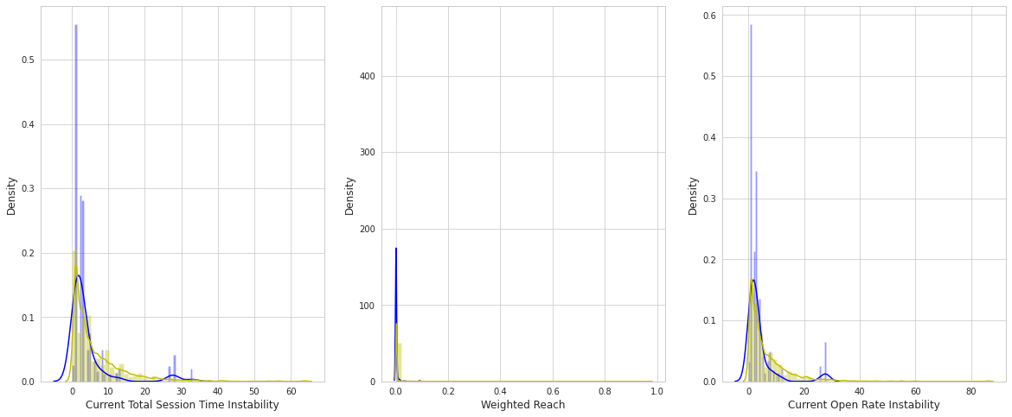
New Features Distribution

Slide 34
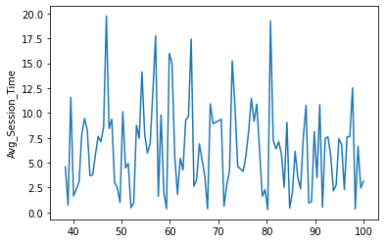
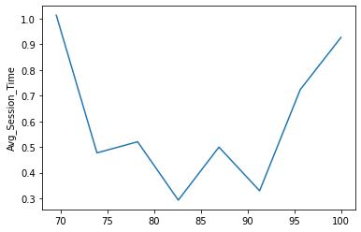
Stability in Non-funded and Funded
Zero crossing=42 Zero crossing=2

Slide 35
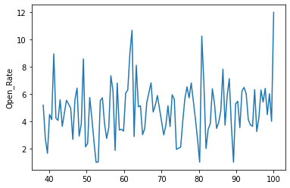
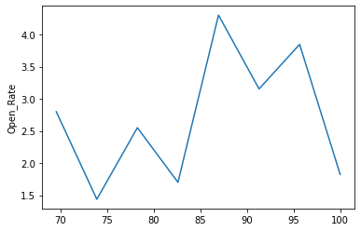
Stability in Non-funded and Funded
Zero crossing=50 Zero crossing=3

Slide 36
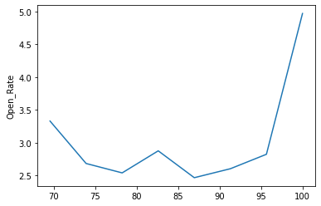
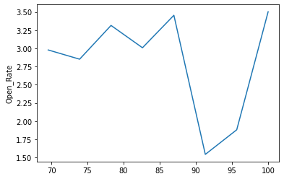
Stability in Non-funded and Funded(open rate)
Zero crossing=2 Zero crossing=2

Slide 37
Definitions of top predictors
1. | Current Open Rate instability | Instability in trend for company’s open rate.
2. | Current reach instability | Instability in trend for company’s reach
3. | Current total session Time instability | Instability in trend for company’s Total Session Time
4. | Weighted Average Reach | We have given more weightage to recent months as compared to previous months and then calculated the average of the reach based on all the previous records.

Slide 38
5. | Dominance in Current Total Session Time | Indicates the dominance level of a company in its application category based on it’s Total Session Time
6. | Dominance in Current Reach | Indicates the dominance level of a company in its application category based on it’s Reach
7. | Dominance in Current Open rate | Indicates the dominance level of a company in its application category based on it’s Open rate
8. | % change in open_rate | Percentage change in open rate with respect to previous months open rate
9. | % change in Uninstall Rate | Percentage change in Uninstall with respect to previous months Uninstall rate

Slide 39
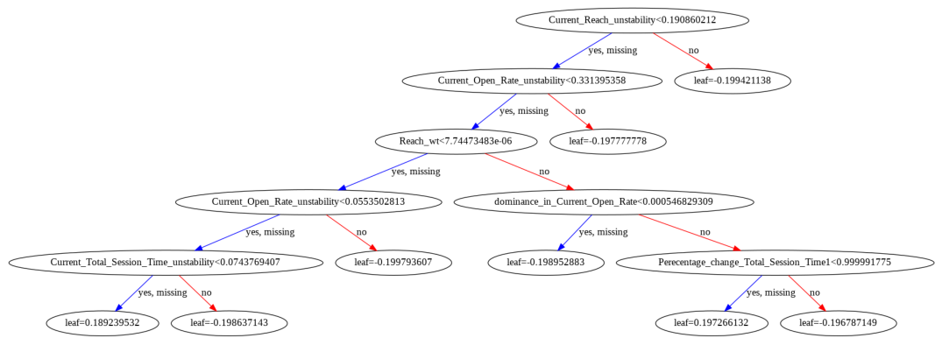
Simple Decision Tree

Slide 40
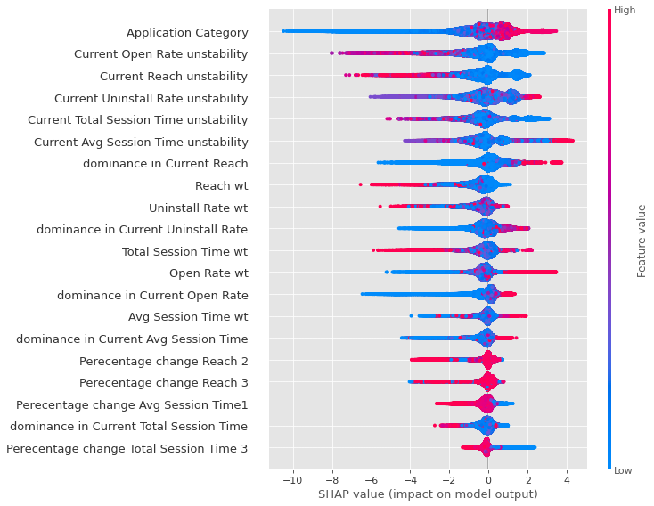
Impact of key drivers on model predictions

Slide 41
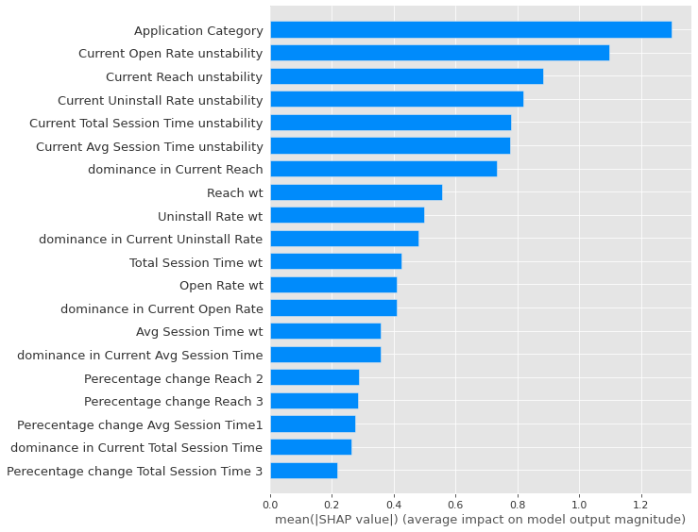
Shap Plots for Feature Importance

Slide 42
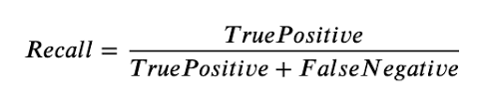
Objective : High Recall Predictive Model
As a venture capitalist, people seek to invest in startups with high ROI, so we are trying to make a model that should accurately predict startups that can get funding in the upcoming three months.
That is to have high recall
We wanted to have high Recall value for Funded Startups. We gave 90% weightage for correct classification of 1 i.e Funded Startups.

Slide 43
Challenges
Huge dataset with lots of missing and redundant values.
Filtering was tricky.
Imputing null values was very challenging and time taking process.
ML problem formulation was tricky.

Slide 44
Conclusion
Overall accuracy is 98%.
With 68% of recall, we can predict the start-ups that will receive fundings in the next three months.

Slide 45
Further plans to improve
We can collect few Important Information Like Business Model for Non Funded Startups
We can try different time windows to increase the Performance.

Slide 46
Q & A

